Slide 1
Number System
Presented by
Syed Shakil Mahmud
Lecturer
Department of Computer Science and Engineering
Bangladesh Army International University of Science and Technology

Slide 2

Introduction to Number System
Outlines
Types of Number System
Conversion of Number System

Slide 3
What is a Number?
A number is a mathematical value used for counting, measuring, or labeling objects. Numbers are used to perform arithmetic calculations. Examples of numbers are natural numbers, positive numbers, negative numbers etc.
1,2,3 …….
-1, -2,-3 …..
1/2, 1/3, 1/4, ….

Slide 4
What is a Number System?
A number system is defined as a system of writing to express numbers. It is the mathematical notation for representing numbers of a given set by using digits or other symbols in a consistent manner.
The value of any digit in a number can be determined by:
The digit
Its position in the number
The base of the number system

Slide 5
Types of Number System
Based on the base value and the number of allowed digits, number systems are of many types. The four common types of Number System are-
Decimal Number System
Binary Number System
Octal Number System
Hexadecimal Number System

Slide 6
Decimal Number System
A number system with a base value of 10 is termed a Decimal number system.
It uses 10 digits i.e. 0-9 for the creation of numbers.
Here, each digit in the number is at a specific place with a place value of a product of different powers of 10.
Here, the place value is termed from right to left as first place value called units, second to the left as Tens, so on Hundreds, Thousands, etc.

Slide 7
Decimal Number System
For example, 10264 has place values as,
(1 × 10^4) + (0 × 10^3) + (2 × 10^2) + (6 × 10^1) + (4 × 10^0)
= 1 × 10000 + 0 × 1000 + 2 × 100 + 6 × 10 + 4 × 1
= 10000 + 0 + 200 + 60 + 4
= 10264

Slide 8
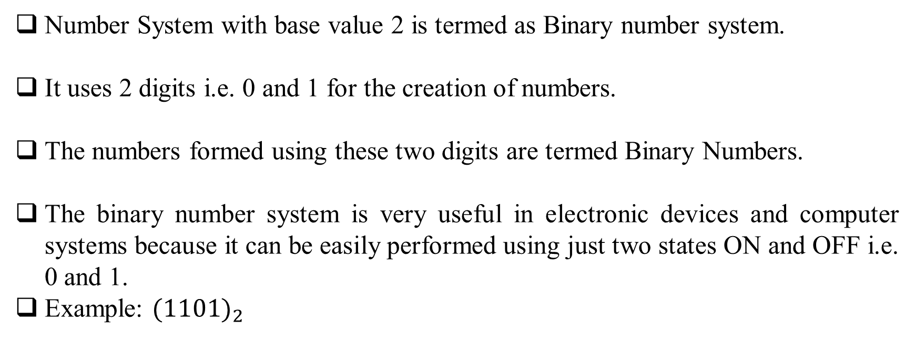
Binary Number System

Slide 9
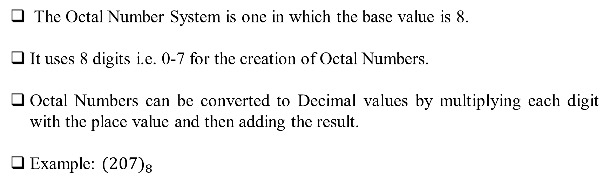
Octal Number System

Slide 10
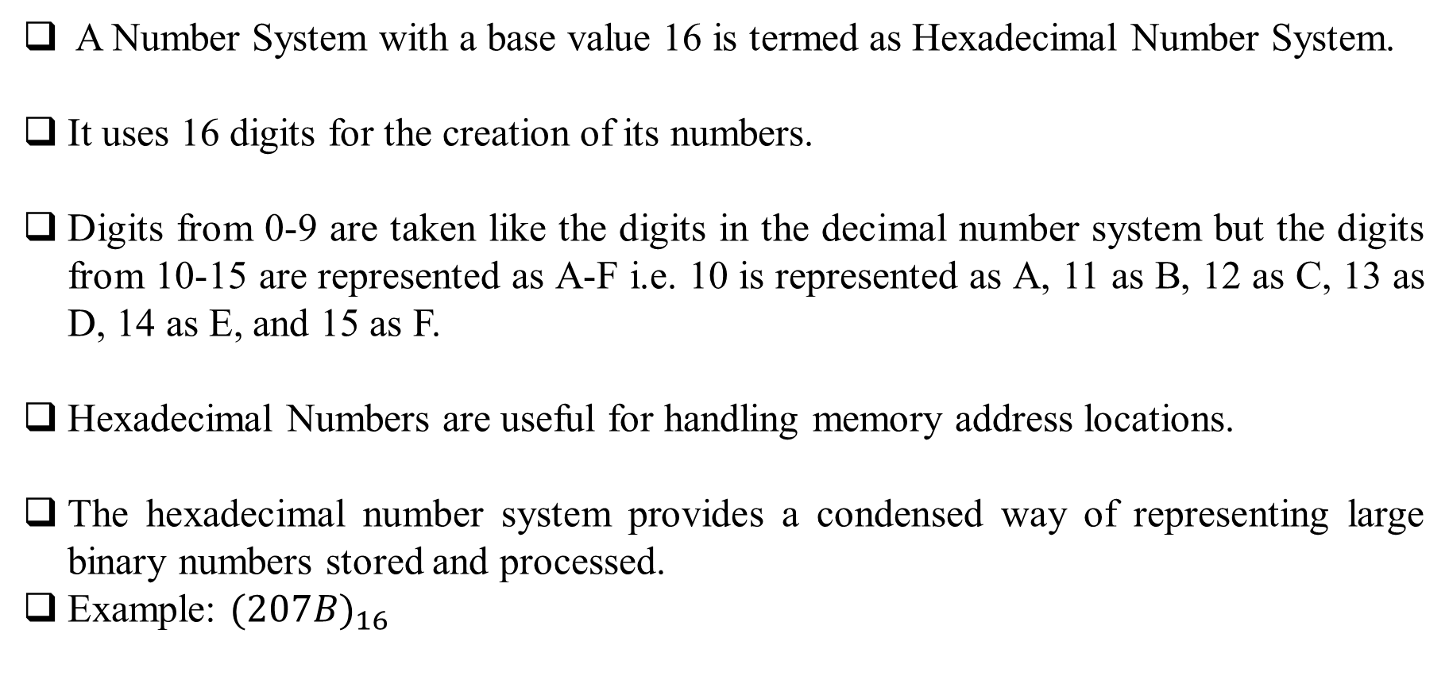
Hexadecimal Number System

Slide 11
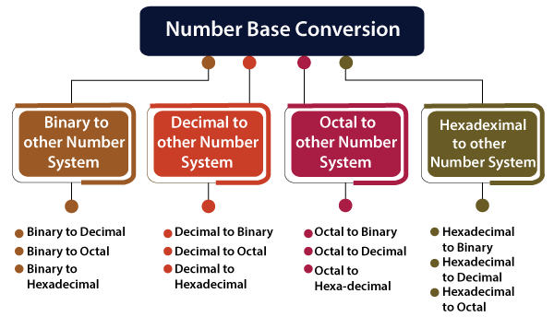
Number System Conversion

Slide 12
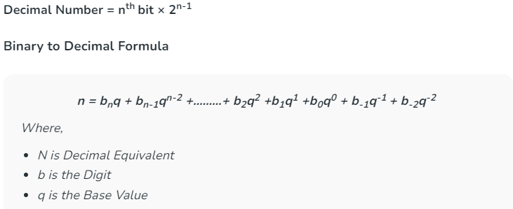
Binary to Decimal Conversion
To convert a binary number to decimal we need to perform a multiplication operation on each digit of a binary number from right to left with powers of 2 starting from 0 and add each result to get the decimal number of it.

Slide 13
Binary to Decimal Conversion
Example 1: (10110.001)₂
We multiplied each bit of (10110.001)2 with its respective positional weight, and last we add the products of all the bits with its weight.
(10110.001)2 = (1×2^4)+(0×2^3)+(1×2^2)+(1×2^1)+(0×2^0)+(0×2^-1)+(0×2^-2)+(1×2^-3)
(10110.001)2 = (1×16)+(0×8)+(1×4)+(1×2)+(0×1)+(0×1⁄2)+(0×1⁄4)+(1×1⁄8)
(10110.001)2 = 16+0+4+2+0+0+0+0.125
(10110.001)2 = (22.125 )₁₀

Slide 14
Binary to Octal Conversion
The base numbers of binary and octal are 2 and 8, respectively. In a binary number, the pair of three bits is equal to one octal digit. There are only two steps to convert a binary number into an octal number which are as follows:
In the first step, we have to make the pairs of three bits on both sides of the binary point. If there will be one or two bits left in a pair of three-bit pairs, we add the required number of zeros on extreme sides.
In the second step, we write the octal digits corresponding to each pair.

Slide 15
Binary to Octal Conversion
Example 1: (111110101011.0011)₂
Firstly, we make pairs of three bits on both sides of the binary point.
110 101 011.001 1
On the right side of the binary point, the last pair has only one bit. To make it a complete pair of three bits, we added two zeros on the extreme side.
111 110 101 011.001 100
Then, we wrote the octal digits, which correspond to each pair.
(111110101011.0011)2=(7653.14)₈

Slide 16
Binary to Hexadecimal Conversion
The base numbers of binary and hexadecimal are 2 and 16, respectively. In a binary number, the pair of four bits is equal to one hexadecimal digit. There are also only two steps to convert a binary number into a hexadecimal number which are as follows:
In the first step, we have to make the pairs of four bits on both sides of the binary point. If there will be one, two, or three bits left in a pair of four-bit pair, we add the required number of zeros on extreme sides.
In the second step, we write the hexadecimal digits corresponding to each pair.

Slide 17
Binary to Hexadecimal Conversion
Example 1: (10110101011.0011)₂
Firstly, we make pairs of four bits on both sides of the binary point.
111 1010 1011.0011
On the left side of the binary point, the first pair has three bits. To make it a complete pair of four bits, add one zero on the extreme side.
0111 1010 1011.0011
Then, we write the hexadecimal digits, which correspond to each pair.
(011110101011.0011)₂=(7AB.3)₁₆

Slide 18
Example :
Convert the following binary numbers to decimal, octal and hexadecimal:
11010100
1011.001
1010.1011
10010.0101

Slide 19
Example :
Convert the following binary numbers to decimal, octal and hexadecimal:
11010100 Ans: 212, 324, D4
1011.001
1010.1011
10010.0101

Slide 20
Example :
Convert the following binary numbers to decimal, octal and hexadecimal:
11010100 Ans: 212, 324, D4
1011.001 Ans: 11.125, 13.1, B.2
1010.1011
10010.0101

Slide 21
Example :
Convert the following binary numbers to decimal, octal and hexadecimal:
11010100 Ans: 212, 324, D4
1011.001 Ans: 11.125, 13.1, B.2
1010.1011 Ans: 10.6875, 12.54, A.B
10010.0101

Slide 22
Example :
Convert the following binary numbers to decimal, octal and hexadecimal:
11010100 Ans: 212, 324, D4
1011.001 Ans: 11.125, 13.1, B.2
1010.1011 Ans: 10.6875, 12.54, A.B
10010.0101 Ans: 18.3125, 22.24, 12.5

Slide 23
Decimal to Binary Conversion
For converting decimal to binary, there are two steps required to perform, which are as follows:
In the first step, we perform the division operation on the integer and the successive quotient with the base of binary(2).
Next, we perform the multiplication on the fraction.

Slide 24
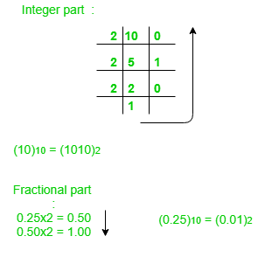
Decimal to Binary Conversion

Slide 25
Decimal to Octal Conversion
For converting decimal to octal, there are two steps required to perform, which are as follows:
In the first step, we perform the division operation on the integer and the successive quotient with the base of octal(8).
Next, we perform the multiplication on the fraction and the successive quotient with the base of octal(8).

Slide 26
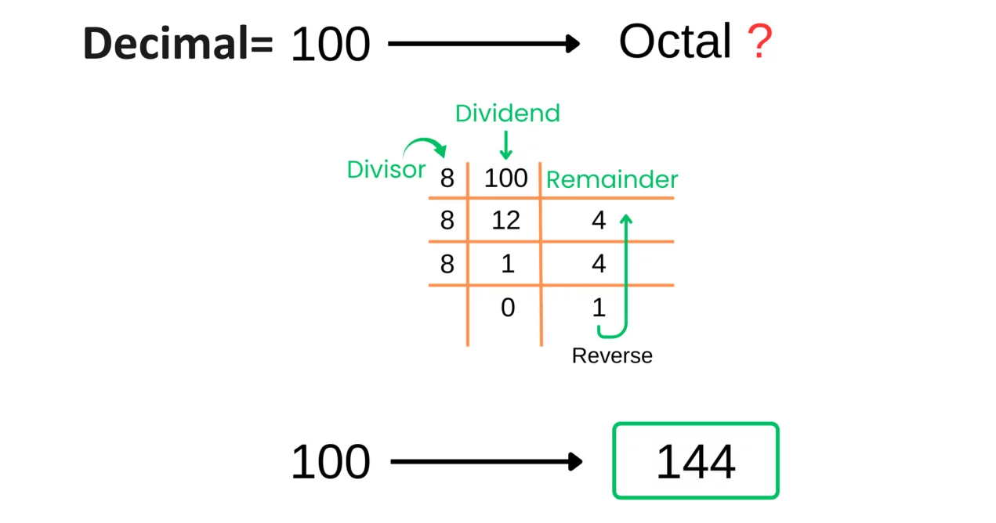
Decimal to Octal Conversion

Slide 27
Decimal to Hexadecimal Conversion
For converting decimal to hexadecimal, there are two steps required to perform, which are as follows:
In the first step, we perform the division operation on the integer and the successive quotient with the base of hexadecimal (16).
Next, we perform the multiplication on the fraction and the successive quotient with the base of hexadecimal (16).

Slide 28
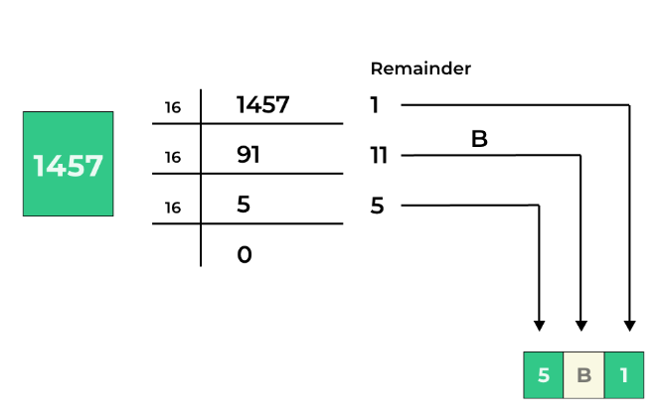
Decimal to Hexadecimal Conversion

Slide 29
Example :
Convert the following decimal numbers to binary, octal and hexadecimal:
94.327
755
185.15
390.919

Slide 30
Example :
Convert the following decimal numbers to binary, octal and hexadecimal:
94.327 Ans: 1011110.0101, 136.2473 , 5E.53B6
755
185.15
390.919

Slide 31
Example :
Convert the following decimal numbers to binary, octal and hexadecimal:
94.327 Ans: 1011110.0101, 136.2473 , 5E.53B6
755 Ans: 1011110011, 1363, 2F3
185.15
390.919

Slide 32
Example :
Convert the following decimal numbers to binary, octal and hexadecimal:
94.327 Ans: 1011110.0101, 136.2473 , 5E.53B6
755 Ans: 1011110011, 1363, 2F3
185.15 Ans: 10111001.001, 271.1146, B9.2666
390.919

Slide 33
Example :
Convert the following decimal numbers to binary, octal and hexadecimal:
94.327 Ans: 1011110.0101, 136.2473 , 5E.53B6
755 Ans: 1011110011, 1363, 2F3
185.15 Ans: 10111001.001, 271.1146, B9.2666
390.919 Ans: 110000110.1110, 606.7264, 186.EB43

Slide 34
Octal to Decimal Conversion
Step 1: Since an octal number only uses digits from 0 to 7, we first arrange the octal number with the power of 8.
Step 2: We evaluate all the power of 8 values such as 80 is 1, 81 is 8, etc., and write down the value of each octal number.
Step 3: Once the value is obtained, we multiply each number.
Step 4: The final step is to add the product of all the numbers to obtain the decimal number.

Slide 35
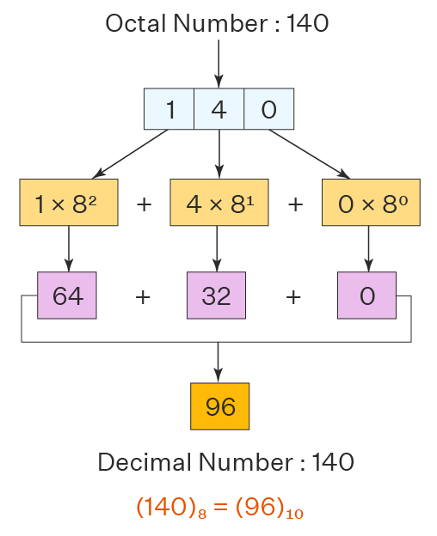
Octal to Decimal Conversion

Slide 36
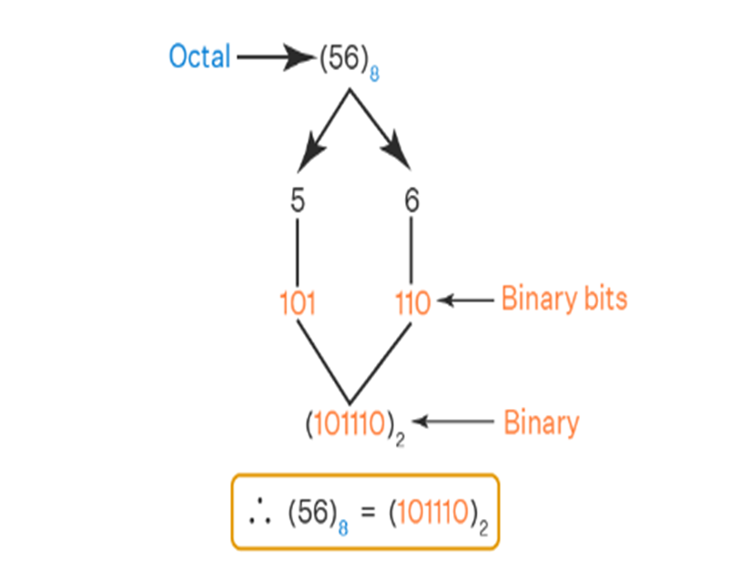
Octal to Binary Conversion
Step 1: Write each digit of the octal number separately.
Step 2: Convert each digit into an equivalent group of three binary digits.
Step 3: Combine these groups to form the whole binary number.

Slide 37
Octal to Hexadecimal Conversion
Step 1: We need to convert the Octal number to Binary first. For that, follow the steps given in the above conversion.
Step 2: Now to convert the binary number to Hex number, divide the binary digits into groups of four digits starting from right to left i.e. from LSB to MSB.
Step 3: Add zeros prior to MSB to make it a proper group of four digits(if required)
Step 4: Now convert these groups into their relevant decimal values.
Step 5: For values from 10-15, convert it into Hex symbols i.e from A-F

Slide 38
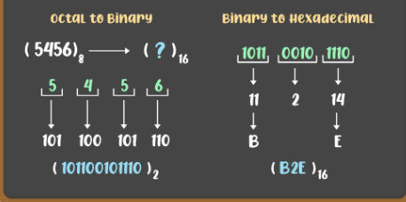
Octal to Hexadecimal Conversion

Slide 39
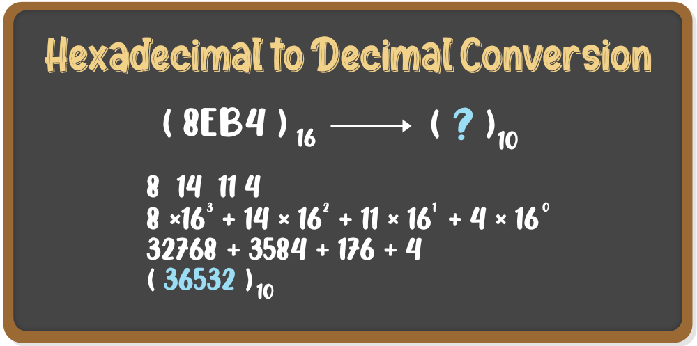
Hexadecimal to Decimal Conversion
Step 1: Write the decimal values of the symbols used in the Hex number i.e. from A-F
Step 2: Multiply each digit of the Hex number with its place value. starting from right to left i.e. LSB to MSB.
Step 3: Add the result of multiplications and the final sum will be the decimal number.

Slide 40
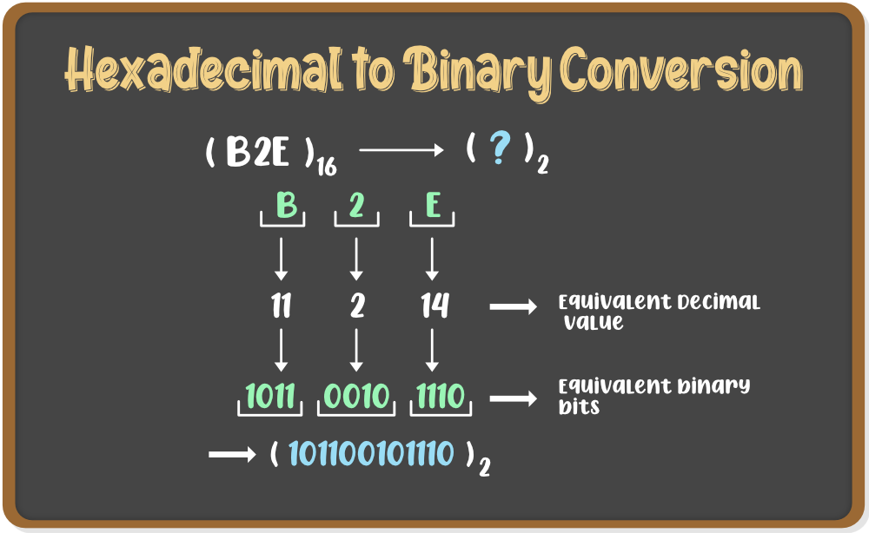
Hexadecimal to Binary Conversion
Step 1: Convert the Hex symbols into its equivalent decimal values.
Step 2: Write each digit of the Hexadecimal number separately.
Step 3: Convert each digit into an equivalent group of four binary digits.
Step 4: Combine these groups to form the whole binary number.

Slide 41
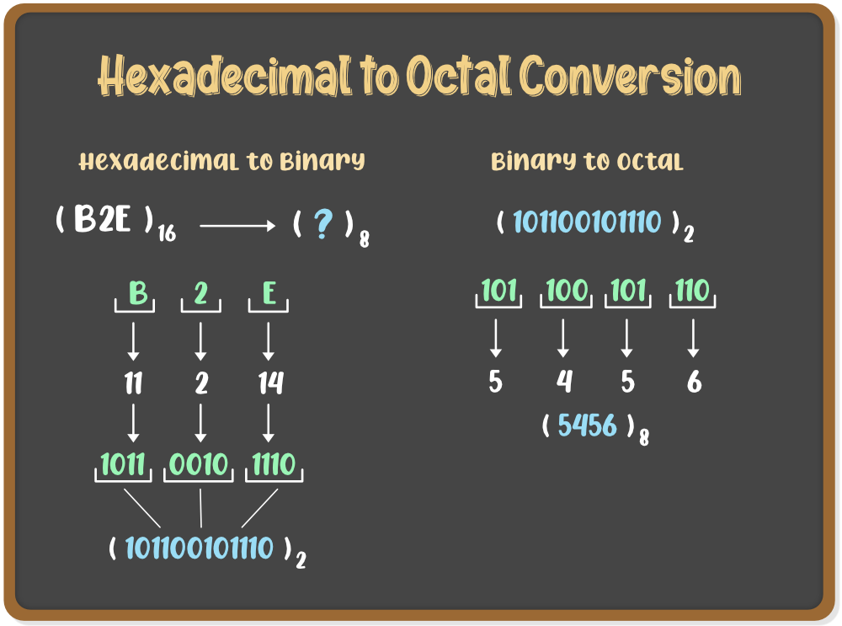
Hexadecimal to Octal Conversion
Step 1: We need to convert the Hexadecimal number to Binary first. For that, follow the steps given in the above conversion.
Step 2: Now to convert the binary number to Octal number, divide the binary digits into groups of three digits starting from right to left i.e. from LSB to MSB.
Step 3: Add zeros prior to MSB to make it a proper group of three digits(if required)
Step 4: Now convert these groups into their relevant decimal values.

Slide 42

Any Questions?

Slide 43
Thank You

